Slide 1
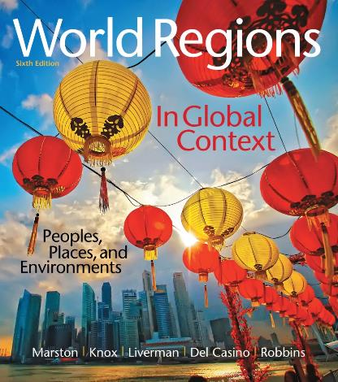
World Regions in Global Context:
Peoples, Places, and Environments
6th Edition
The Russian
Federation, Central
Asia, and the
Transcaucasus
Lectures by:
Christa Ann Smith

Slide 2
Learning Outcomes
Describe the physical geography of the Russian Federation, Central Asia, and the Transcaucasus Region.
Predict how climate change and environmental impacts of human activities may influence the region’s future sustainability.
Explain how people have adapted to and modified the physical landscapes in this world region.

Slide 3
Learning Outcomes
Describe how economic transitions in the region are playing out in the post-Socialist era.
Analyze the changing political trends in the region in terms of fragmentation and realignment.
Summarize the cultural legacies and new developments in the region in terms of high, revolutionary, and popular forms of culture.
Discuss and analyze the implications of demographic change in the region.

Slide 4
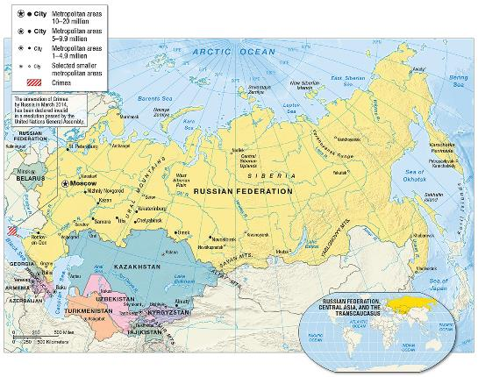
Environment, Society, and Sustainability
Vast territory, sparsely populated
Borders: Eastern Europe, the Arctic, and the Pacific Ocean
Southern
borders: Middle
East, South Asia,
and East Asia

Slide 5
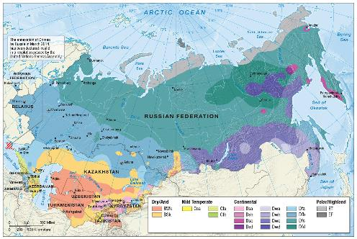
Climate and Climate Change
Four major climate zones
  Arid
  Semiarid
  Continental/Midlatitude
  Polar
    permafrost

Slide 6
Adapting to a Warming Continent and Melting Sea Ice
Climate change: positive affects
  milder winters in the northern latitudes
  longer growing seasons
  increased water availability
Climate change: negative affects
  melting of permafrost
  heat waves/increased forest fires
  geopolitical implications

Slide 7
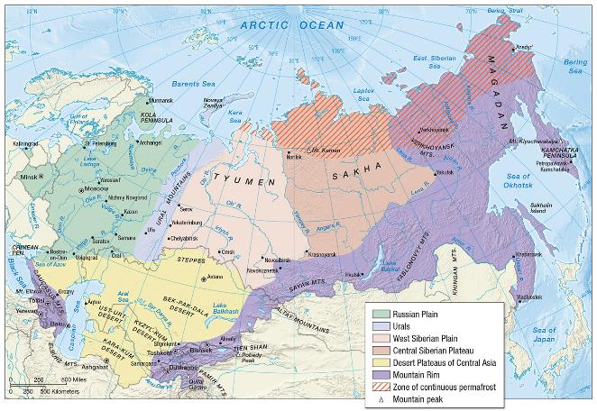
Geological Resources, Risk, and Water
Physiographic regions

Slide 8
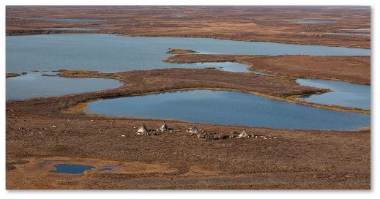
Geological Resources, Risk, and Water (cont.)
Plains
  geologically stable
  agricultural
  heartland
  Russia’s major
  rivers
  marshy, poorly
  drained areas
  oil and gas reserves

Slide 9
Geological Resources, Risk, and Water (cont.)
Mountains
  highest range: Caucasus Mountains
  Urals
    mineral wealth
    industrial cities
  mountain rim
    geologic instability: earthquakes and volcanoes
Central Asia
  geosyncline
  oil reserves
  gas reserves

Slide 10
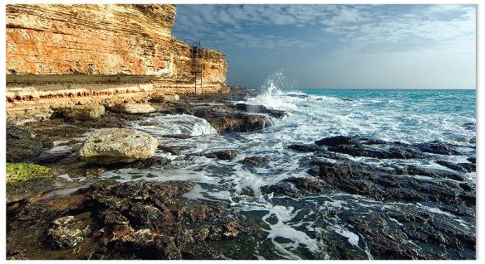
Geological Resources, Risk, and Water (cont.)
Rivers
  Lena
  Ob’
  Amur
Seas/Lakes
  Caspian Sea
  Black Sea
  Lake Baykal

Slide 11
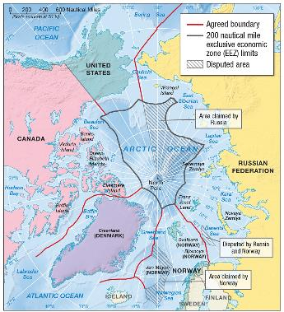
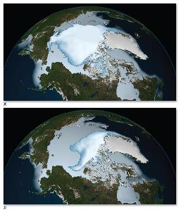
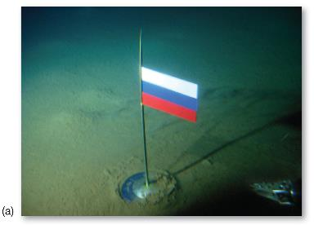
The Arctic
Northwest Passage
  global trade
Global climate change
  new commercial routes
  access to seafloor
  negative impact on wildlife
  geopolitical ramifications

Slide 12
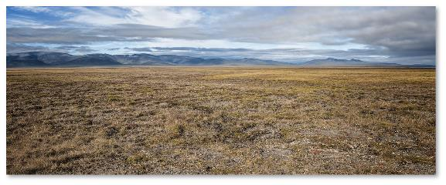
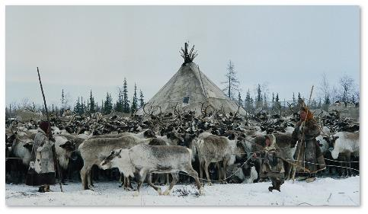
Ecology, Land, and Environmental Management
Five zones
  climate patterns
Tundra
  most northerly
  arctic wilderness
    winters: weak daylight; snow
    summers: long days; bogs and marshes
  indigenous peoples
    reindeer herders

Slide 13
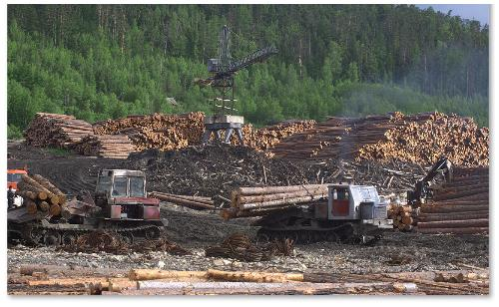
Ecology, Land, and Environmental Management (cont.)
Taiga
  most extensive zone
  coniferous forest
  spruce, fir, and pine
  fur-bearing animals
Mixed forest
  large-scale logging operations
  privatization of timber industry
  environmental concern

Slide 14
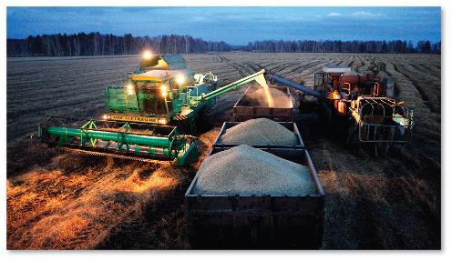
Ecology, Land, and Environmental Management (cont.)
Steppe
  flat grassland
  limited rainfall
  cleared for agriculture
  wheat belt
  corn and cotton

Slide 15
Ecology, Land, and Environmental Management (cont.)
Semidesert and desert
  Central Asia
    salt pans
  nomadic pastoralists
  extensive sand dunes
  scattered oasis and a few fertile valleys

Slide 16
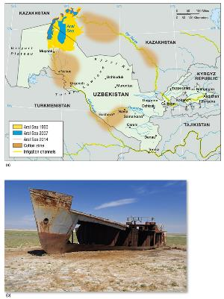
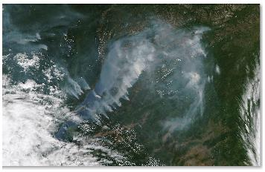
Challenges to Sustainability in the Region
Over-exploitation of Aral Sea
Pollution of rivers and lakes
Increased hazards of summer fires
Offshore oil drilling threatens marine ecosystems

Slide 17
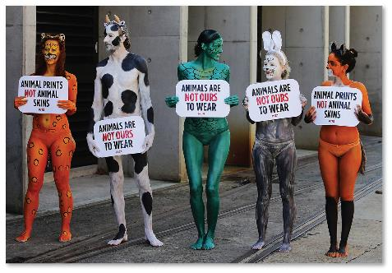
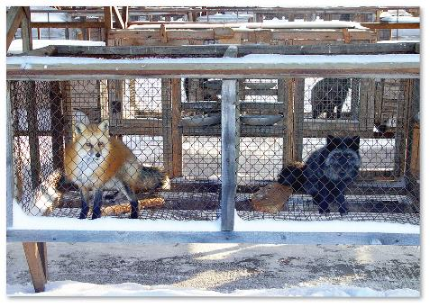
Furs
15 billion global retail sales
Status symbol and luxury item
Controversy
  extinction
  fur farming
Activism
Fashion comeback

Slide 18
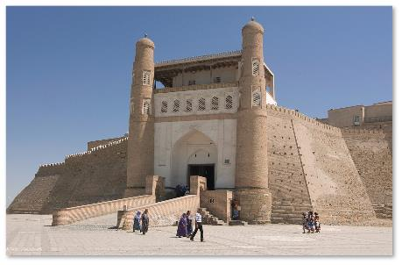
Historical Legacies and Landscapes
Silk Road
  Central Asia
    connected China and the Mediterranean
  Samarkand
    center of mathematics, music, and Islamic architecture
    khans, nomadic people in the region

Slide 19
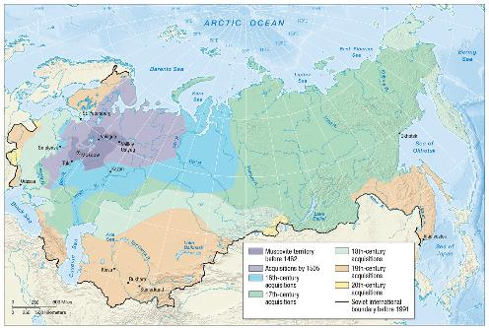
The Rise of the Russian Empire
Principality of Muscovy
  centered around the city of Moscow
  in 1552, Ivan the Terrible freed Muscovy from the Tatars
  steady expansion of Russian dominance
  tsars (rulers of Russian empire)

Slide 20
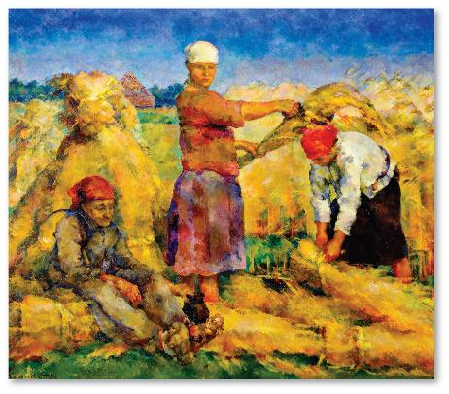
The Rise of the Russian Empire (cont.)
Early 20th century: severe depression
Soviets formed in protest
  discontent
World War I further put tsars in disfavor
October 1917
  Bolshevik Revolution
  Soviet Union established

Slide 21
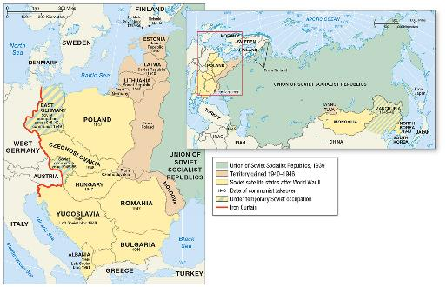
The Rise of the Russian Empire (cont.)
State socialism
  people’s compliance
Lenin
  internationalist
  Union of Soviet
  Socialist Republics
Stalin
  anti-nationalism
  expansion into Eastern Europe
  command economy
  severe repression
  collectivization

Slide 22
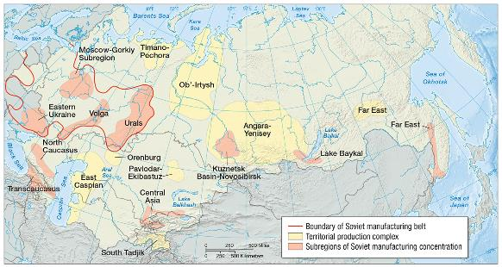
The Rise of the Russian Empire (cont.)
Growth
  territorial production complexes
  industrialization of less-developed subregions
  “secret cities”
Cold War
  1950–1989
  communism
  challenged the
  dominance of
  capitalism (the
  United States)
  proxy conflicts

Slide 23
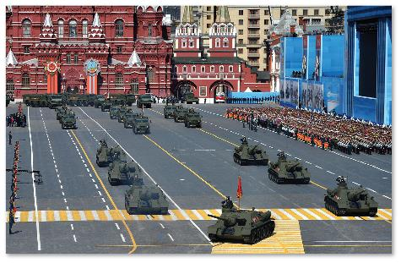
The Rise of the Russian Empire (cont.)
Soviet Union in crisis by 1980
  failure to deliver consumer goods
  population was
  becoming informed of
  consumerism elsewhere
  regional inequities
  economic drain
  of the arms race
  inflexibility and
  lack of computer
  technology
  between 1989 and 1991, the Soviet Union broke apart into 15 independent states

Slide 24
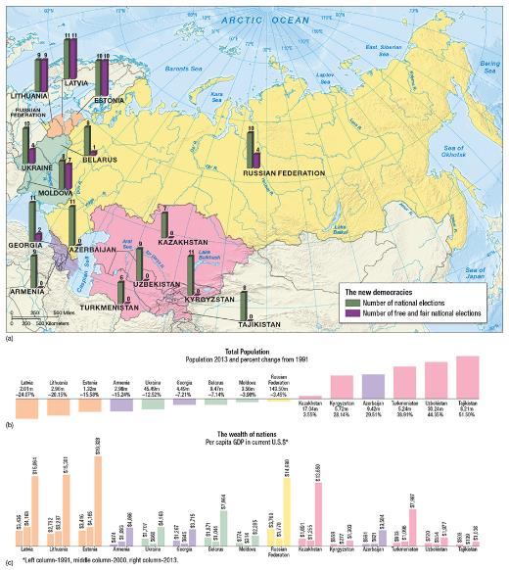
Economy, Accumulation, and the Production of Inequality
Shift to capitalism after 70 years of central planning has been problematic
Mafiyas (organized crime groups)
Oligarchs
Economic growth dramatic between 2000 and 2014
End of 2013, Russia 9th largest economy in the world

Slide 25
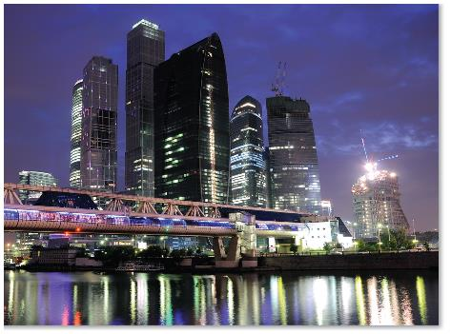
Economy, Accumulation, and the Production of Inequality (cont.)
The Central Region
  centered on Moscow
  85% urban
  major contributor to
  Russian Federation
  production
Regions of decreasing
prosperity
  regions of territorial conflict
  resource-poor regions

Slide 26
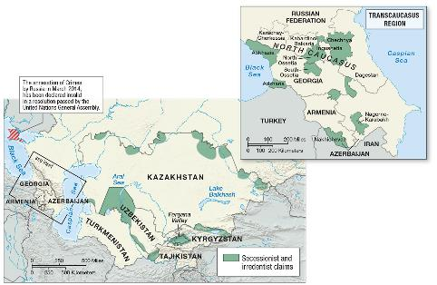
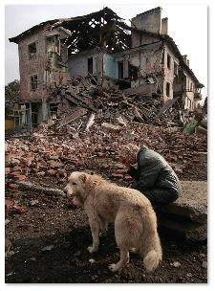
Territory and Politics
27 million non-Russians
Chechen
independence
  Sunni Muslims
  Soviet treatment of Chechens
  glasnost
  1989 declaration of independence
  Russian invasion
  in 1994
  fall of Grozny
  in 2000

Slide 27
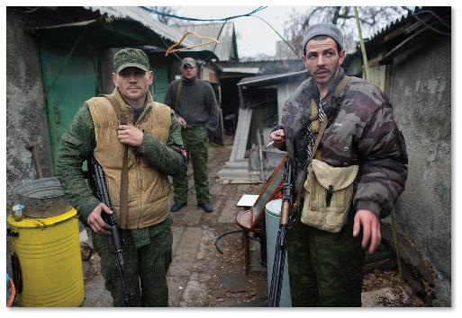
Territory and Politics (cont.)
Transcaucasus and Central Asia
Ethnonationalism
  Nagorno-Karabakh
    Armenian citizens
    of Azerbaijan
    civil war
    oil pipeline
  South Ossetia
    Georgia
  Tajikistan
    civil war
  Fergana Valley
    Uzbekistan

Slide 28
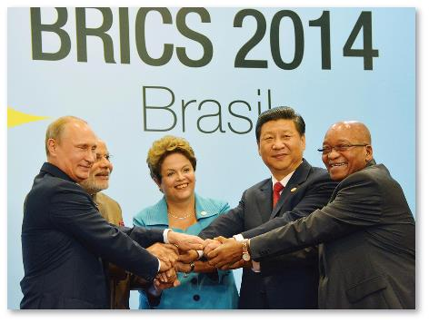
Territory and Politics (cont.)
Geopolitical shifts
  Commonwealth of Independent States (CIS)
  Near Abroad
    Russia’s expanding political influence
  civil society
  pluralist democracy
  BRICS

Slide 29
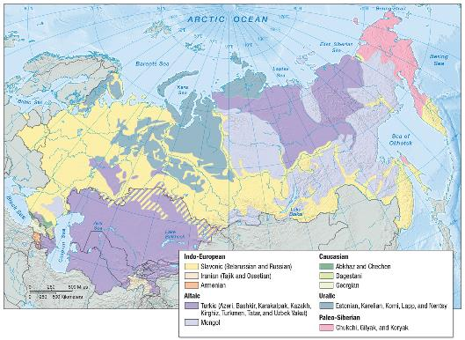
Religion and Language
Religion
  Eastern Orthodoxy
    Russia and Georgia
  Islam
    Azerbaijan and Central Asia
Language
  Slavonic
  Turkic
  Paleo-Siberian
  Caucasian

Slide 30
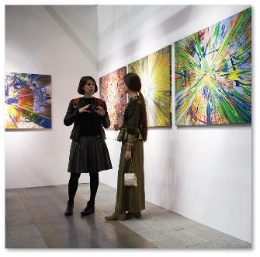
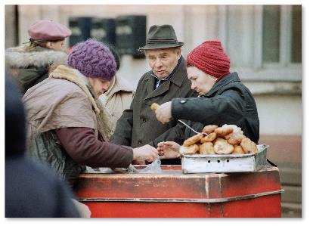
Cultural Practices, Social Differences, and Identity
High culture
  influenced by European art
    classical music, ballet, novels, and poetry
Popular culture
  influenced by the Soviet era
  influenced by the West
  food traditions
  modern Art

Slide 31
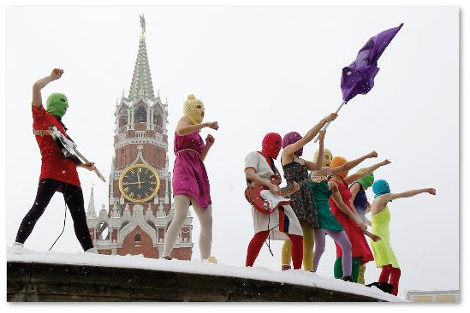
Gender and Inequality
Gender and identity
  Soviet era
  new opportunities
  legally off-limits jobs
  wage disparity
  regressed political
  representation

Slide 32
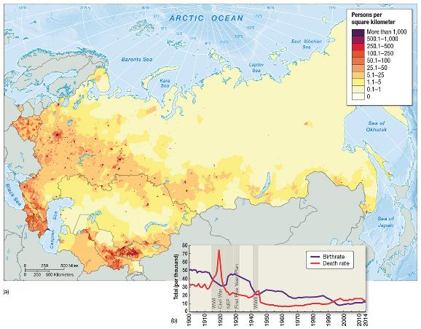
Demography and Urbanization
Low population density
Higher urbanization in Russia
Population
growth and
decline
  slow-growing
  population
  higher birthrates
  in Central Asia
  rising mortality
  rates among
  men

Slide 33
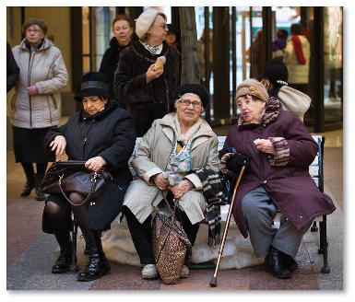
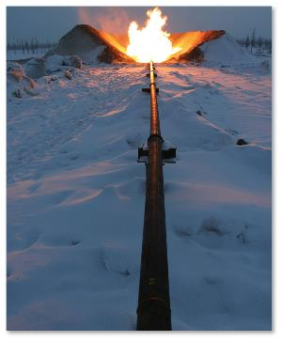
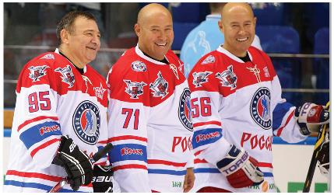
Future Geographies
Energy dependency
Democracy and plutocracy
  elites as sources of corruption
Far East economic boom
Demographic implosion?
  aging population

